Slide 1
Learning Outcomes Assessment: Reflecting on the Past and Planning for the Future
Dr. Robert J. Awkward
Director of Learning Outcomes Assessment
Friday, September 13, 2019

Slide 2
Reflecting on the Past
Amcoa Team Meetings:
Sept. 28: Institutional Assessment Program Panel: UMass Amherst, Framingham State, and Northern Essex Community College; and Salem State & ACUE
Nov. 30: Dr. Patricia O’Brien, SND & Dr. Laura Gambino, NECHE – “Making Assessment More Meaningful”
Feb. 1: QORE - “Say it Loud: Using Oral Presentations to Assess General Education”
April 5: Dr. Laura Bayliss, Fitchburg State University – “Building a Comprehensive Student Affairs Assessment Program”
Task Force on Statewide Assessment:
Oct. 16: Dr. James Dottin, Middlesex Community College – “Program Assessment: A Journey from Compliance to Engagement”
Jan. 17: Dr. Emily Williams, Mass. College of Liberal Arts – “Assessment Across the Regions”
March 1: Merri Incitti, Fitchburg State University – “Holistic Approaches to Student Learning”

Slide 3
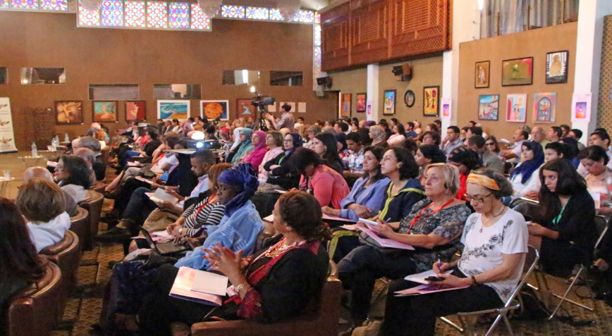
Reflecting on the Past
Eighth Annual Assessment Conference
“The Intersectionality of Equity, Quality, & Student Learning”
Friday, April 19, 2019 @ Best Western Royal Plaza Hotel & Trade Center, Marlborough, MA
Decline in attendees from 130 to 115 (11.5%) largely due to Work-to-Rule at state universities
Two of the nine had no attendees
Six had one to three attendees
Overall conference Very Satisfied/Satisfied score of 91%; down slightly from 2018 (96.5%)
Dr. Gianina Baker, NILOA; Very Satisfied/Satisfied = 86%; down from 96.5% in 2018
Morning Breakout Sessions Very Satisfied/Satisfied score of 94% (vs. 92% in 2018) based on Faculty-Led Assessment (4), Assessing for Value (2), and Universal Design (2)
Afternoon Breakout Sessions Very Satisfied/Satisfied score of 78.2% (vs. 92% in 2018) based on Understanding Critique as a Form of Assessment (3), Quantitative Literacy (3), and Oral Presentations (2)

Slide 4
Reflecting on the Past
Topics for Next Year’s Annual Assessment Conference
Examples of things done to assess that are innovative, but valid and reliable
More information about assessment activities in STEM and disciplines that have accreditation standards
More guidelines for faculty on how to conduct assessment at their college (ex. MCC)
More applied examples of how to address equity
Some structured networking time would be great
How to prepare and plan data gathering, both immediate and long-term in order to effectively conduct assessment

Slide 5
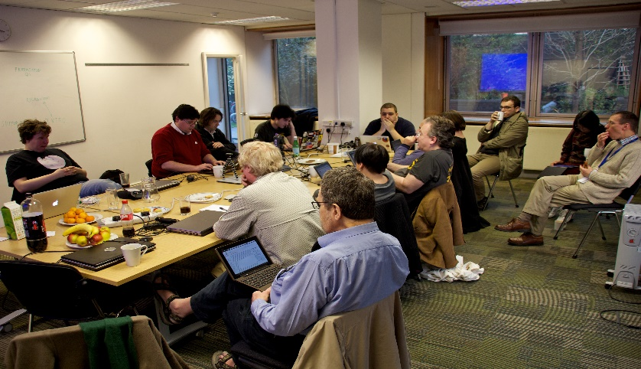
Reflecting on the Past
Regional Professional Development
Assignment Design Charrettes:
November 2: North Region at North Shore Community College – Dr. Sara Strout, Worcester State University, Facilitator
December 7: Boston Metro Region at UMass Boston – Dr. Bonnie Orcutt, Worcester State University, Facilitator
January 25: Central Region at Quinsigamond Community College – Dr. Ruth Slotnick, Bridgewater State University, Facilitator
February 8: West Region at Westfield State University – Dr. Sara Strout, Worcester State University, Facilitator

Slide 6
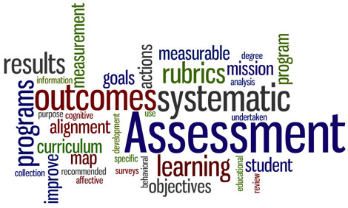
Reflecting on the Past
VALUE Institute
Institutional Leaders Kickoff Meeting, Sept. 20: Guest Presenter - Dr. Brian Doore, Unity College, Unity, ME (nee Director of Assessment for University of Maine System)
Area of Focus: Critical Thinking
Planned Actions Based on 2016-2017 Data:
Regional Assignment Design Charrettes
Regional Quantitative Literacy Workshops (postponed until Fall, AY2020)
Ten Institutions Selected
AAC&U Webinar – “The Landscape of Learning: What We Know from the Inaugural Year of the VALUE Institute” on December 4, 2018

Slide 7
VALUE Institute Participating Institutions: 2018-2019
University of Massachusetts System
UMass Amherst
UMass Boston
State Universities
Salem State University
Community Colleges
Cape Cod Community College
UMass Lowell
Fitchburg State University
Westfield State University
Worcester State University
North Shore Community College
Northern Essex Community College
Eight out of ten categories of institutional types covered
Missing:
High tech. institution and high minorities (i.e., STCC)
Small institution with low minorities (e.g., Greenfield)
New participants:
UMass Boston
Cape Cod Community College (returning)

Slide 8
MassTransfer Pathways Student Learning Outcomes
Communication & Media Studies (revised from 2018):
Human Communication
Interpersonal Communication
Film Studies/History and Criticism of Film
Mass Communications (nee Media Studies)
Business Administration:
Financial Accounting
Managerial Accounting
Marketing
Management
Business Law
Computer Applications
Criminal Justice:
Introduction to Policing
Introduction to Criminal Justice
Introduction to Corrections
Criminology
Criminal Law

Slide 9
Reflecting on the Past
Open Education Resources (OER)
Convened an OER Working Group
Sub-committees met multiple meetings, identified areas of focus, conducted research, and made recommendations
Held two OER Working Group meetings: February and April 2019
Presented draft recommendations to the Board of Higher Education’s Academic Affairs Committee: April 2019
Presented to the Northeast OER Conference at UMass Amherst (P. Marshall & R. Awkward, DHE & S. Teixeira, SAC): May 2019
Finalized draft report and submitted for institutional review and feedback

Slide 10
Planning for the Future
Amcoa Team Meetings (all at QCC):
Fri., Sept. 13: Dr. Peggy Maki - “Real-Time Assessment: A Shared Commitment to Students’ Equitable Progress Toward Achieving High-Quality Outcomes”
Fri., Nov. 15: TBD
Fri., Feb. 7: TBD
Fri., March 27: TBD
Task Force on Statewide Assessment (all at QCC):
Oct. 8: TBD
Jan. 15: TBD
March 6: TBD
Ninth Annual Assessment Conference: Friday, April 17; Place TBD

Slide 11
Planning for the Future
Regional Professional Development
Quantitative Literacy Faculty Workshops: Fall 2019
Objectives: Addresses area of focus from Refinement Year MSC, improve student learning, expand the use of quantitative literacy across the curriculum, links learning & teaching with assessment, better data, and equity
Expected Outcomes: Create more effective assignments, employ the use of TILT design, and illustrate student utilization of quantitative literacy
Targeted to cross-discipline faculty
Incentives for attendance: Hands-on session using their own assignment/syllabus, held on Friday, and food
Regionally located, i.e., North at UMass Lowell (10/11), Boston Metro at UMass Boston (10/18), Central at Quinsigamond Community (10/25), West at Holyoke Community College (10/25), and Southeast (Bridgewater State at SEQuEL Conference)
Support the SEQuEL Conference at Bridgewater State
Guest presenters (Dr. Matt Salomone, Bridgewater State University and Dr. Mary-Ann Winkelmes, Brandeis University (TILT) via video and utilizing local faculty to facilitate

Slide 12
Planning for the Future
Regional Professional Development
Regionally-Developed Faculty Workshops: Spring 2020
Objectives: Improve teaching and student learning, links learning & teaching with assessment, and equity
Expected Outcomes: Create more effective teaching practices and increased learning outcomes
Targeted to cross-discipline faculty
Incentives for attendance: Hands-on session, held on Friday, and food and refreshments
To be regionally located, i.e., Boston Metro, Central, North, Southeast, and West

Slide 13
Planning for the Future
Assessment Program Design One Day Workshop for Institutional Teams
Friday, October 4
Framingham State University’s Warren Conference Center, Ashland, MA
Focus will be on institutional teams of up to five to develop or strengthen their assessment program
Food and refreshments to be provided
Facilitator: Dr. Mark Nicholas,
Executive Director of Institutional Assessment
Framingham State University

Slide 14
MassTransfer Pathways Student Learning Outcomes
Carryover from AY 2018
Early Childhood Education
For AY 2020
General Education Foundation
Carryover from AY 2019
Elementary Education
Engineering
Fine Arts & Graphics

Slide 15
Planning for the Future
Open Educational Resources (OER) Working Group
Incorporate Campus Feedback into the Final OER Report
Present the Final OER Report to the Board of Higher Education
Academic Affairs Committee: 10/15
Board of Higher Education: 10/22
Implement Recommendations (as approved):
Adopt a Statewide Definition
Convene a Statewide OER Advisory Council
Designate a Statewide OER Coordinator
Designate OER Courses in Course Management System
Continue to Support Student Advocacy
Join, Coordinate with, and Learn from Regional and National OER Advocacy Organizations
Continue to Educate Key Stakeholders, e.g., Legislators, Campus Administration, Faculty, etc.
Continue to Provide Faculty Professional Development for OER

Slide 16
Questions…Comments?
Thank You!!

